Slide 1















Jain Hackathon Project Presentation
Jill Gosrani Grp Id: 1861
Jaynam Sanghvi Grp Id: 1915

Slide 2

Understanding Problem Statement
Module 1 was all about gathering and managing data for making smart investment choices. We had to collect information from various sources like Zillow, redfin, apartments.com, etc. and user inputs, then cleans and organizes this data. The goal was to provide an accurate, real-time information that other parts of the system can easily use for analysis and decision-making.
Module 2 focused on market analysis for the collected modular data. It has two main objectives:
To continuously scans and evaluate new properties, to quickly identify potential investment opportunities as they come on the market.
To analyze market trends to provide strategic insights into factors that could affect property investments.
Module 3 focused on automating the underwriting process for property investments. To implement this we can use algorithms and real-time data to assess financial viability, operational efficiency, and risks associated with potential investments. The module performs automated financial analysis, risk assessment, and regulatory compliance checks, while also providing recommendations to help investors make informed decisions.

Slide 3
Ideation process for each day
01
02
03
04
05
06
Understanding the problem statement and project requirements
Explored our options for different data scraping tools and technologies. And websites where we can scrape data from.
Applied for different APIs to get white listed for legal scraping of data..
Attom API approval mail and started data scraping process.
Due to high computation need and low system specification. Our system crashed and had to start data scraping from start
Decided to integrate Api with the backend and call the API to list the property listings on the UI

Slide 4

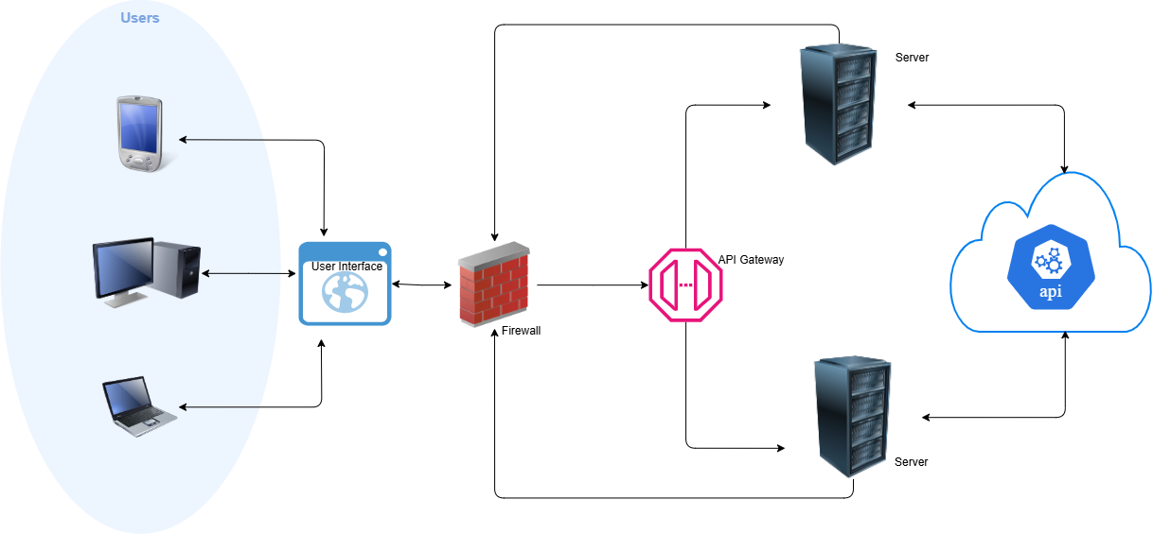
High- level Design

Slide 5
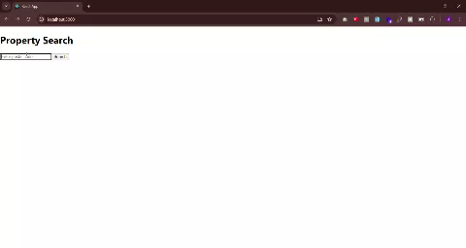
Demo Video

Slide 6
Thank you very much!

